Slide 1
Object Oriented Programming Lecture-12
Methods in Java: Methods, Parameters passing, Returning Multiple values
Prof. Varsha Dange

Slide 2
Methods in Java
In Java, a method is a set of code used to write the logic of the applications which perform some specific tasks or operations.
a method is executed when it is called from another method.
The main() method is the first method that is executed by JVM in java program.
If we want to execute any other method, we should call it from the main() method or anywhere in Java program.
When a method is called, it may or may not returns a value to the calling method.

Slide 3
Why do use Methods in Java
The purpose of using methods in the Java program is to write the logic of the applications.
We cannot write directly the business logic of the application.
It is invalid syntax because inside the class,
Therefore, we declare the method inside the class and write the logic inside the methods.
Example

Slide 4
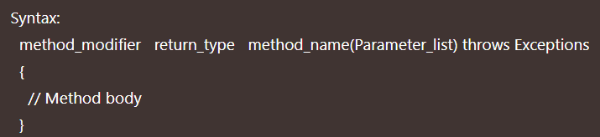
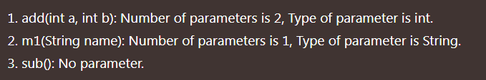
Method declaration & Types of Methods
A method must be declared inside the class.
The basic syntax to declare a method is as follows:
Method Signature in Java-some examples of methods signature are:

Slide 5
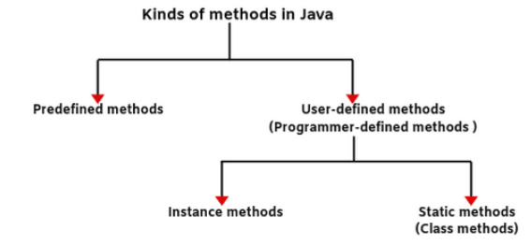
Types of Methods in Java

Slide 6
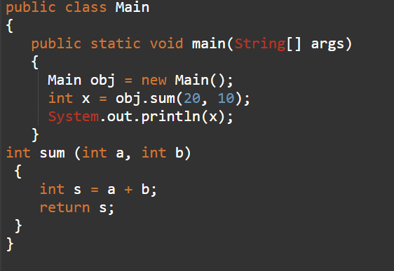
Arguments/Parameters in Java
A parameter is a variable in the definition of a method .
an argument is an actual value of this variable that is passed to the method’s parameter.
Example

Slide 7
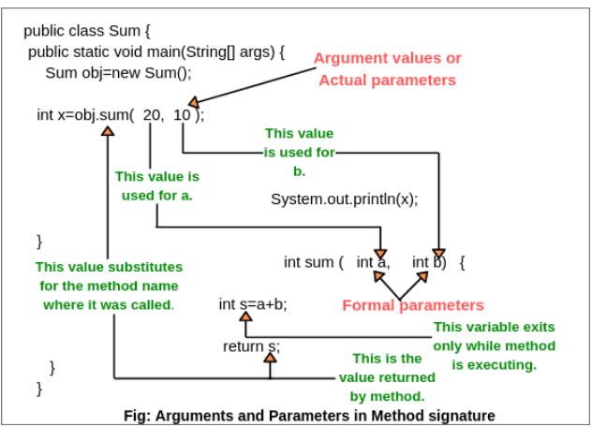
Arguments/Parameters in Java

Slide 8
Parameters passing
Pass by Value and Pass by Reference
In Java, all argument values are passed to a method using only pass by value mechanism.
There is no pass by reference mechanism in Java.

Slide 9
Pass by Value in Java
“Pass by value” in Java means that argument’s value is copied and is passed to the parameter list of a method.
In this parameter passing method, values of actual parameters are copied to method’s formal parameters and the two types of parameters are stored in different memory locations.
So any changes made inside functions are not reflected in actual parameters of the caller.
Example
Example

Slide 10
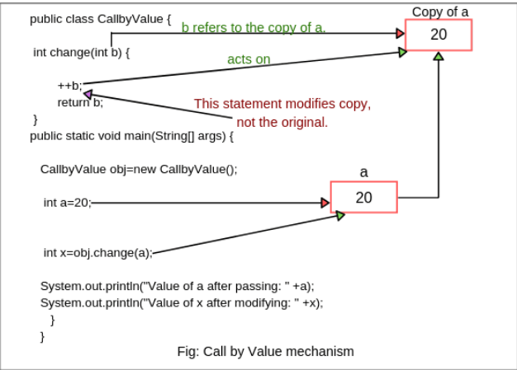
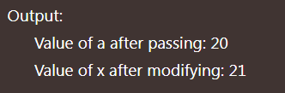
Pass by Value in Java

Slide 11
Pass by Reference in Java
C/C++ supports the pass by reference because in the pass by reference we pass the address of actual parameters in the place of formal parameters using Pointers(address).
And Java does not support Pointers that’s why Java does not support pass by Reference
There are different ways to achieve pass by reference in Java
passing the object
Passing collections or array as a parameter

Slide 12
Pass by Reference in Java
“Pass by Reference” means passing a reference of the object by value to a method.
when we pass a reference (variable of class type) as an argument to a method, actually, a copy of a reference to an object is passed by value to the method, not a copy of the object itself.
Both the actual and formal parameters refer to the same locations, so any changes made inside the method are actually reflected in actual parameters of the caller.
Example(Object)
Example(Array)
Example
Example

Slide 13
Return type in Java
A method can accept data from outside and can also return the results.
To return the result, a return statement is used inside a method to come out of it to the calling method.
In Java, return is a keyword that is used to exit from the method only with or without returning a value.
Every method is declared with a return type in java and it is mandatory for Java methods.
Return type may be a int, float, double etc or a reference type, or void type which represents “return nothing.
return a value must be compatible with the declared return type by using the return statement.
Example

Slide 14
How to Return class object in Java
In Java class, we return different class objects as returning values.
Example

Slide 15
Returning Multiple values in Java
Java doesn’t support multi-value returns.
We can use following solutions to return multiple values.
If all returned elements are of same type
We can return an array in Java. Example
If there are more than one returned value
We can encapsulate all returned types into a class and then return an object of that class. Example
If you want to return unrelated values, then you can use Java's built-in container classes like Map, List, Set etc.

